Slide 1

Architecture Clasification

Slide 2
Architecture clasification
Monolith Architetcutures
Distributed Architectures
Single deployment unit
Multiple deployment units
Notes:
•Stilurile de arhitectura faciliteaza folosirea unor structuri deja definite pentru a suporta requirementurile non-functionale ale businesului

Slide 3


Arhitecturi Monolitice
Puncte forte
Puncte slabe
Simplu de implementat
Implementare mai rapidă
Deployment mai rapid
Costuri reduse
Greu de scalat
Greu de obținut fault tolerance
Elasticitate redusă
Timpi mari de recovery - MTTR și MTTS
Notes:
•MTTR (Mean time to recovery) and MTTS (Mean time to start)
•O data ce apare un failure, e nevoie de un timp mai indelungat pentru ca systemul sa pornesca- de exemplu un desktop monolith app with tons of dlls and jars

Slide 4
Examples of monolith architectures
Layered Architecture
Modular Monolith
Pipeline Architecture
MicroKernel Architecture

Slide 5
Distributed Architectures
Strong Points
Weak Points
Scalability
Fault Tolerance
Performance *
Agilitate
Reduced recovery time
Bad assumptions
Network is reliable
Bandwith is infinite
Latency is 0
Common issues
Handle distributed transactions
Eventual consistency
Workflow management
Error Handling
Data synchronization
Contract management
Notes:
•Cuprind mai multe servicii ale caror scop este sa indeplineasca o functie a businesului
Puncte forte - •Scalabilitate
•Fault Toleranc Daca unul din servicii nu mai functioneaza, celelalte servicii nu sunt afectate
•MTTS and MTTR sunt mult mai reduse decat in cazul arhitecturilor monolitice
Puncte slabe - •Toate acesta complexitate duce la in cost mai mare de implementare initiala dar si de mentanta decat arhitecturile de tip monolith

Slide 6
Distributed architectures examples
Event Driven
Microservice
Service Based
Service Oriented
Space Based

Slide 7
How do we chose the type of architecture?
Does the entire system need to be scaled or only part of it?
If you need fault tolerance and high reliability then go for distributed architectures
MVP
Monolith architectures are less expensive
Notes:
daca sistemnul nu trebuie sa scaleze in nici o parte, dar tot vrei o separare mergi spre un modulit (modular monolith)
MVP - vrei doar sa testezi piata - si e controlat loadul daca e deployed ( internal networks, ) subscription based

Slide 8
Architecture Partitioning
Technically partitioned
Domain Partitioned
components are organized from a technical point of view
Exemples: Layered, Microkernel, Pipeline, Event Driven si Space-based
Components are organized by domain areas, presentation, business and persistance layer are grouped together
They gain popularity due to DDD
Facilitate teams to better collaborate with domain experts and focus on a part of the system
Exemples: Microkernel, microservice, modular monolith and service based
Notes:
•Pe langa clasificare in arhitecturi de tip monolit
si distribuit, arhitecturile se pot clasifica si dupa modul de partitionare a systemului
Technically partitioned - In this architecture style, components are organized by technical layers; for example, presentation components that have to do with the user interface, business layer components that have to do with business rules and core processing, persistence layer components that interact with the database, and the database layer containing the data for the system.
-Exemple cand se preteaza – daca majoritatea changurilor sunt isolate intro arie technical specifica – de exemplu – schimbare de look and feel , care nu schimba logica din spate ,
-De asemenea daca business rules se modifica constant dar data layer si presentation layer nu se pre schimba
-Dar daca nu se potriveste: Ganditiva ca trebuie sa adaugati o data de expirare pe itemele din wishlistul customerului, acest change va necesita un db change , adaugare de noua coloanal, modificari in business layer si schimvarea contractului intreb business si presentation layer. Acest tip de change e considerat un domain change mai mult
-
-Domain partitioning : exemplte . App.customer, app.payment, app.orders
-Daca revenim inapoi la changeul de mai sus , changurile se vor vor fi splicate doar intr-o parte a sustemului app.customer.wishlist – toate celel 3 ( persentation,business, persitance) sunt in aceeasi zona => easier maintance , easier testing ,

Slide 9
How do we chose the type of partitioning?
We have to consider
Team structure
Types of changes in the system
Technical Partitioning
If the team structure is also in layers(front-end developers, back-end developers and database engineers)
Types of changes are usually happening in a single layer( eg: UI changes only, swapping the database )
Domain Partitioning
Each team constains all roles or there are full stack developers involved
Changes are usually domain specific

Slide 10
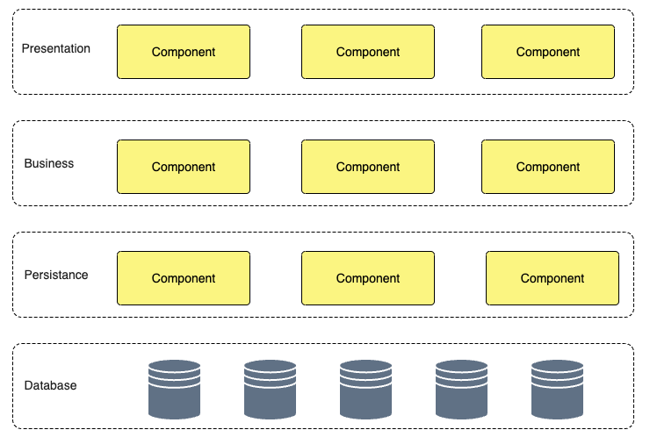
Layered Architecture

Slide 11
Layered Architecture
Fiecare layer are o responsabilitate specifică
Concepte
Upper layers have no knowledge about inner layers
Each layer can be opened or closed
Notes:
eg:importanta ca leyerele sa nu aiba knowledge despre inner layers - daca vrei sa schimbi - angular cu vueJS - daca contractele din Presentation ar fi aceleasi cu cele din business - ar fi greu de schimbat.
Daca sunt diferite - e usor de schimbat
2. la fel si cu schimbatul si cu persistance layer - daca schimbi de la sql la nosql - nu ar trebui sa fie impactat altceva decat persistance layer

Slide 12
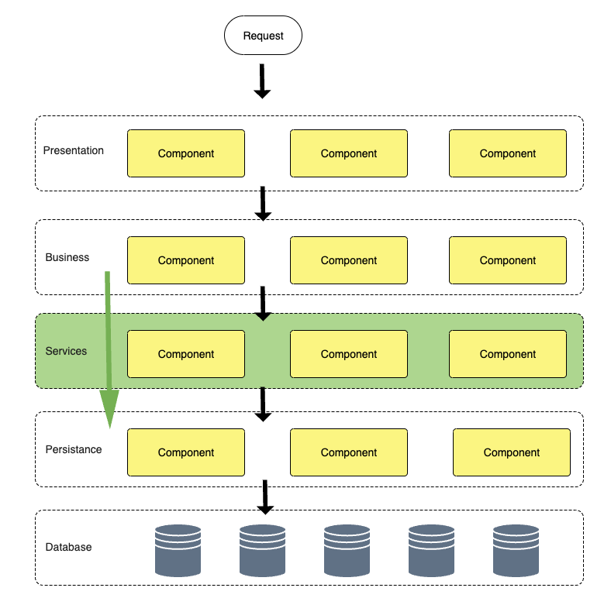
Open Layer
Notes:
3. Open layer - Cateodata ai nevoie ca sa poti face bypass la un layer si sa treci la urmatorul. Daca de exemplu sunt servicii utility ( nu ai vrea sa fortezi business layer sa treaca prin acest layer de servicii_

Slide 13
When do we use Layered Architecture?
The type of architecture is not clear in the begining
Changes tend to be at layer level
Separate teams: Fronted/Backend/Database
sinkhole antipattern
high scalability, fault tolerance, elasticity ( 100% of application needs to scale)
changes are at domain level
Notes:
sinkhole antipatttern - requesturile trec prin layers dar nu se intampla nimic in acele layers, doar e chemat next layer
fiecare arhitectura layer inevitabl va avea requesturi care sunt din aceasta categorie, trebuie analizat procentul ( acceptable 20% sa fie asa) - consider to make some layers openend
fault tolerance
un crash intr-o parte a aplicatie pune jos tot sistemul
schimbarile sunt la nivel de domeniu
adaugarea unei expirari la wishlist ( db change, business changes (ce faci cand expira), si la nivel UI arata un expiration date
daca ai mai multe echipe - toti trebuie sa se coordoneze pentru un change relativ mic

Slide 14


Characteristics - Layered architecture
Rating
Partitioning type
Technical
Overall Cost
Agility
Simplicity
Scalability
Fault Tolerance
Performance
Extensibility

Slide 15
MicroKernel Architecture
Plugin Module
Core System
Plugin Module
Plugin Module
Plugin Module
Plugin Module
Plugin Module

Slide 16
Microkernel Architecture
Core system takes care of generic functionalities and makes sure the specialized module is called
Concepte
Exemple
Core system needs to know how to call the specialized modules: module registry
Modules can be dll/jar - monolith
Modulele can be remote services - distributed
Eclipse
Visual Studio Code
.Net Core/Asp Net Core
System de management al asigurărilor (*)
Notes:
Payment Processing Systems: A payment gateway platform might need to integrate with different banks, credit card providers, and third-party services based on the region or country.
The core system handles transaction management, fraud detection, and basic processing. Meanwhile, plug-in modules are used for region-specific payment processors or currency conversions, allowing the core system to remain payment method-agnostic.
E-commerce Platforms: In an e-commerce platform, the core system could handle user management, product listings, and order processing. Different plug-ins could be used for varying tax systems, payment gateways, and shipping providers based on the geographic location of the store or the user’s preferences. This keeps the core system generic, while the plug-ins adapt it to specific locales or business needs.
Gaming Engines: A game engine might have a core responsible for rendering, physics, and input handling. Plug-ins can be used to adapt the engine for different gaming platforms (PC, console, or mobile) or for different game genres (e.g., adding VR support or real-time multiplayer features). The core engine remains consistent across platforms, while plug-ins provide platform-specific adaptations.

Slide 17
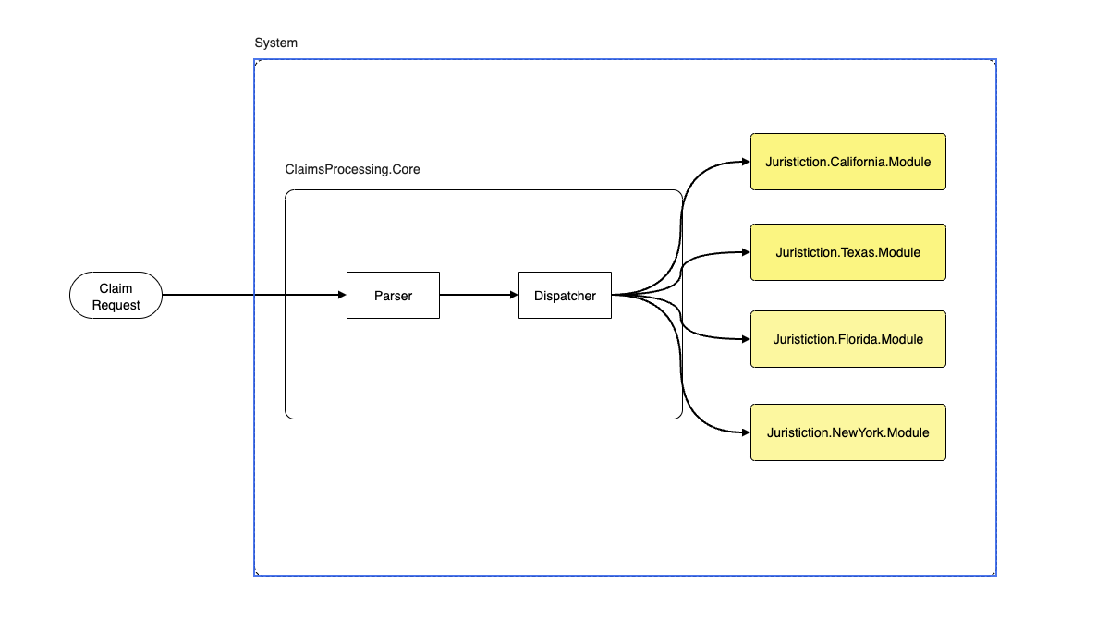
Example
Notes:
toate module trebuie sa respecte un contract ,
Daca sunt dlluri jaruri , ar trebui sa implementeze o interfata
Daca sunt systeme remote sa adere la acelasi contract

Slide 18
When to use MicroKernel?
Easy to extend without modifying the core functionality
Core system can become a bottleneck
If changes in core are happening often
Notes:
•Toate requesturile trec prin core system, chiar daca pluginurile sunt remove, din acest motiv the core system poate deveni un bottleneck ceea ce face arhitectura sa nu fie potrivita pentru sisteme ce trebuie sa fie highly scalable

Slide 19
Caracteristici - Microkernel architecture
Rating
Partitioning type
Technical o Domain
Overall Cost
Agility
Simplicity
Scalability
Fault Tolerance
Performance
Extensibility

Slide 20
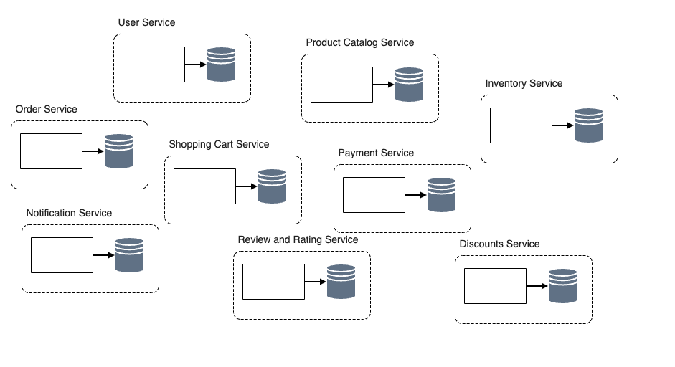
Microservice Architecture

Slide 21
Microservice Architecture
Sistemul este împărțit în mai multe servicii specializate complet independente
Concepte
Data is distributed
structura organizațională trebuie să corespundă cu arhitectura
operational automation
API Gateway
Bounded Context
Notes:
datele sunt distribuite
•Conceptul de Bounded Context – este vital pentru a definii microservicii
•Intreg codul sursa reprezentand un domeniu sau un subdomeniu cat si datele asociate sunt grupate in acelasi unit
•Daca se schimba structura bazei de date, alte servicii nu sunt afectate, contractul prezentat exterior e de cele mai multe ori diferite decat internal data structure
structura organizationala
•Echipele trebuie sa fie cross functionale ( frontend, backend, dba, devops ar trebui sa existe in fiecare echipa
ar trebui sa existe si rolul de service owner pe fiecare serviciu ( de obicei arhitect)
operational automation
Datorita faptului ca de obicei vorbim de zeci, sute sau chiar mii de microservicii deploymentul si monitorizarea necesita orchestrare, ceea ce duce la containerizare si orchestrare
Aplicatia client apeleaza Gatewayul care forwardeaza requestul catre serviciul specializat.
Gatewayul poate sa se ocupe si de cross-cutting infrastructure functions cum ar fi securitatea, culegerea de metrici
Conceptul de Bounded Context – este vital pentru a definii microservicii
Intreg codul sursa reprezentand un domeniu sau un subdomeniu cat si datele asociate sunt grupate in acelasi unit
•Daca se schimba structura bazei de date, alte servicii nu sunt afectate, contractul prezentat exterior e de cele mai multe ori diferite decat internal data structure

Slide 22
Când folosim microservice architecture?
Businessul are funcții distincte pe care le oferă
Aplicația trebuie să se adapteze ușor la schimbări
Scalabilitate și Fault Tolerance
Aplicația trebuie să fie ușor extensibilă
complexitate ridicată
dacă datele sunt tight coupled
latency
team debates
Notes:
Businessul are funcții distincte pe care le oferă
•Exemplul clasic e retail order system ( place order, aplica plata, notifica userul, management de invetar, asigura transportul)
Aplicația trebuie sa se adapteze ușor la schimbări
•Bounded Context ajuta la asta, deoare codul si datele sunt unele langa celelalte. Testarea e mai usoara pentru ca targeteaza doar o sectiune. Deploymentul e mai usor si mai rapid
Scalabilitate și Fault Tolerance
MTTS si MTTR sunt low
Aplicația trebuie sa fie ușor extensibila
E usor sa adaugi o noua functionalitate printr-un nou microserviciu
—-----------
complexitate ridicată
e una din cele mai complexe arhitecturi , asta duce si la costuri ridicate -> costurile licentelor cresc , costurile de hosting cresc
dacă datele sunt tight coupled
•Daca datele sunt tight coupled si nu poti sa le separi in mai multe baze de date. Chiar daca codul poate fi impartit nu e de ajuns
•Daca exista proceduri stocate, views, triggers
latency
•Desi tendinta e sa consideram ca o arhitectura microservice ajuta la performanta sistemlui nu e neaparat cazul deoarece serviciile trebuie sa comunica intre ele
•Network latency
•Security latency
Data latency
team debates
•E greu de trasat o linie clara, vor exista discutii daca un notification system trebuie sa trimita si email si sms sau ar trebui sa fie izolate
•Ce tip de comunicare ar trebui sa fie intre microservicii? Sincrona sau asincrona?
•Ar trebui sa existe un orchestrator service care asigura worflowul sau ar trebui ca serviciile sa comunice direct unele cu altele?
•Daca un serviciu are nevoie de date de la un alt serviciu, ar trebui sa le ceara printr-un API call, sa le stocheze in cache, sa le stocheze in propria baza de date?
Network latency is the amount of time it takes packets of information to reach the target service over the network.
Depending on the type of remote access protocol you are using and the physical distance between services, this can range anywhere from 30 ms to 300 ms or more.
Security latency is the amount of time it takes to authenticate or authorize the request to the remote endpoint.
Depending on the level of security and access control on the remote service endpoint, this latency can range anywhere from a few milliseconds to 300 ms or more.
Data latency impacts the performance aspects of microservices the most. Data latency is the amount of time it takes for other services to query data on your behalf that you don’t own.
For example, suppose the Wishlist service needs to access the product descriptions, and communicates with the Product Catalog service to request the data.
The Product Catalog service, upon receiving the request, must make an additional database call to retrieve the product descriptions.
This is something that doesn’t happen when data is shared in monolithic databases, where a single database call using an inner or outer join is the only thing required to access multiple types of data.

Slide 23
Characteristics - Microservice architecture
Rating
Partitioning type
Domain
Overall Cost
Agility
Simplicity
Scalability
Fault Tolerance
Performance
Extensibility

Slide 24
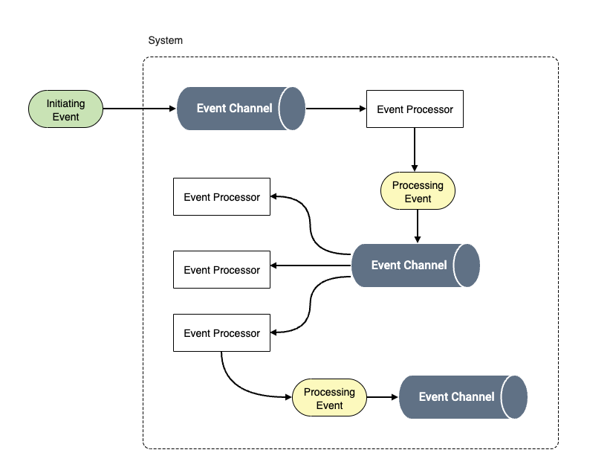
Event Driven Architecture

Slide 25
Event Driven Architecture
Solves the complex workflow problems. Suitable for reactive systems
Concepts
Async processing
Decoupling between producers and consumers
components
event processor
initiative event
processing event
event channel
Notes:
procesare asincrona
consumerul nu trebuie sa fie available cand producerul trimite un event
consumerul consuma in its own pace
decuplare intre produceri si consumer
producerul nu stie de existanta consumerului
componente
event processor
•de obicei un serviciu este unitatea de baza intr-o arhitectura event driven. Poate avea un singur rol ( validarea unui order) sau poate fi ceva complex ( executarea unei tranzactii)
•Poate trimite evenimente asincrone cat si raspunde la evenimente asicrone
initiative event
•Este initiat din afara sistemului principal
•Incepe un worflow ( eg: trimiterea unui order)
•De obicei e procesat de un singur event procesor care initiaza restul worflowuilui , dar pot fi mai multe servicii care reactioneaza la un initiative event
processing event
•se mai numeste si event derivat
•Initiat cand stateul unui serviciu se schimba si restul sistemului e notificat de aceasta schimbare
•Relatia intre un initiative event si processing event e 1 to many
event channel
•Este mediul prin care eventurile se propage ( queue sau topic)

Slide 26
When do we use Event Driven Architecture?
high performance
high scalability
high fault tolerance
System reacts to external or internal events
Complex workflows
decoupling
System react to user actions- CRUD
Requests should be synchronous
Data consistency is vital
complex error handling
Notes:
high performance
high scalability
high fault tolerance
sistemul reactioneaza la evenimente externe sau intern
Intrebarea ar fii, systemul meu raspunde la un user request sau reactineaza la ceva ce userul a facut?
Daca stakeholderii folosesc cuvinte cum ar fi eveniment, trigger, reactioneaza la.
workflow-uri complexe
daca sistemul necesita decision trees complecsi
aceste systeme se numesic si CEP ( Complex event processing)
decoupling
—-----------------------------------------------------
Complex error handling -
Furthermore, because everything is asynchronous, other actions may have occurred in the workflow for that event.
For example, suppose an Order Placement service triggers an Order Placed event for a book that a customer ordered.
The Notification service, Payment service, and Inventory service all respond to the event at the same time.
However, suppose the Notification and Payment services both respond and complete their processing, but the Inventory service throws an error because there are no more books left when the event is received. Now what? The customer has already been notified and their credit card has been charged, but there are no more books left to ship to the customer. Should payment be reversed? Should another notification be sent to the customer? Should processing just wait until there’s more inventory? And which service performs all this error handling logic? Error handing is indeed one of the more complex aspects of event-driven architecture.

Slide 27
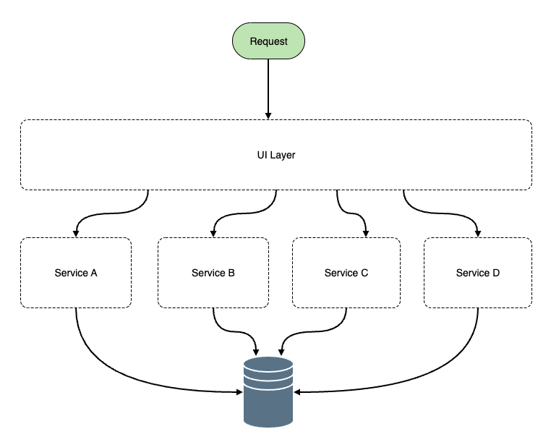
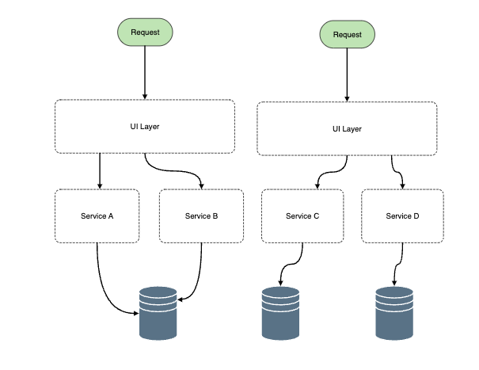
Service based Architecture

Slide 28
Service Based Architecture
Domenii bine definite care sunt deployed separat
Concepte
domain service
max 12 services
single or multiple databases
Notes:
domain service
spre deosebire de microservicii unde sunt pe functionalitati specifice , aici un domeniu se ocupa de o arie mai mare
exemplu in healthcare system o sa ai: Patient Management, Billing and Issurance, Laboratory Information
max 12 services
din cauza ca shareuiesti databaseul , e de preferat sa tii un numar mic de servicii

Slide 29
When do we use service based architecture?
The system has independent domains that do not have to communicate
The database is shared and cannot be split
Step in migration to microservices
Elasticity
High coupling between domains
More than 8-10 services
Notes:
sistemul are domenii independente care nu au nevoie sa comunice între ele
baza de date shared care nu poate fi splitted
migration to microservices
daca incepi un proiect nou care are potential sa mearga spre microservicii
sau daca vrei sa migrezi un monolith catre microservicii, ar trebui first migrat catre un service based - poti identifica domeniile si nu te obliga inca sa spargi dbul
—--
required elasticity - daca trebuie sa raspunzi la high load foarte rapid, nu e ideal =>mai debraba microservicii (MTTS is high)
if the number of services exceed 12
dbul ar trebui spart

Slide 30
Caracteristici - Service Based architecture
Rating
Partitioning type
Domain
Overall Cost
Agility
Simplicity
Scalability
Fault Tolerance
Performance
Extensibility

Slide 31
Appendix 1 - Quality Attributes
Agility
Agility in software architecture refers to the ability of a system's architecture to adapt, evolve, and scale efficiently in response to changing business needs, technological advancements, and operational requirements.
Fault Tolerance
Fault tolerance refers to a system’s ability to continue operating properly in the presence of failures. It ensures that a system can detect, isolate, and recover from faults without causing a complete service outage.
Simplicity
The ease of understanding, maintaining, and modifying a system by reducing unnecessary complexity.
Performance
How efficiently a system executes tasks, measured in terms of speed, responsiveness, and resource usage.
Scalability
The ability of a system to handle increased load by adding resources
Extensibility
The ease of adding new features or modifying existing functionality without major changes

